Slide 1
Qianchen’s Project
(Inquisit Version)

Slide 2
Overall
Aim
To capture the information transfer rate based on phenomenal consciousness, by using patches of images as response opportunities.
To examine whether the informativeness of visual perception is limited by its detailedness (a.k.a resolution)
Replicate previous experiment in MATLAB version to Inquisit version and upload to MTurk to collect experiment data from world.

Slide 3
M-Turk
M-Turk has an advantage that it can have participants from the world. It can have a big cloud of participants which means we can have more data we want than lab version
Size of each experiment will be small and the participant no need to download all of the files but they need.

Slide 4
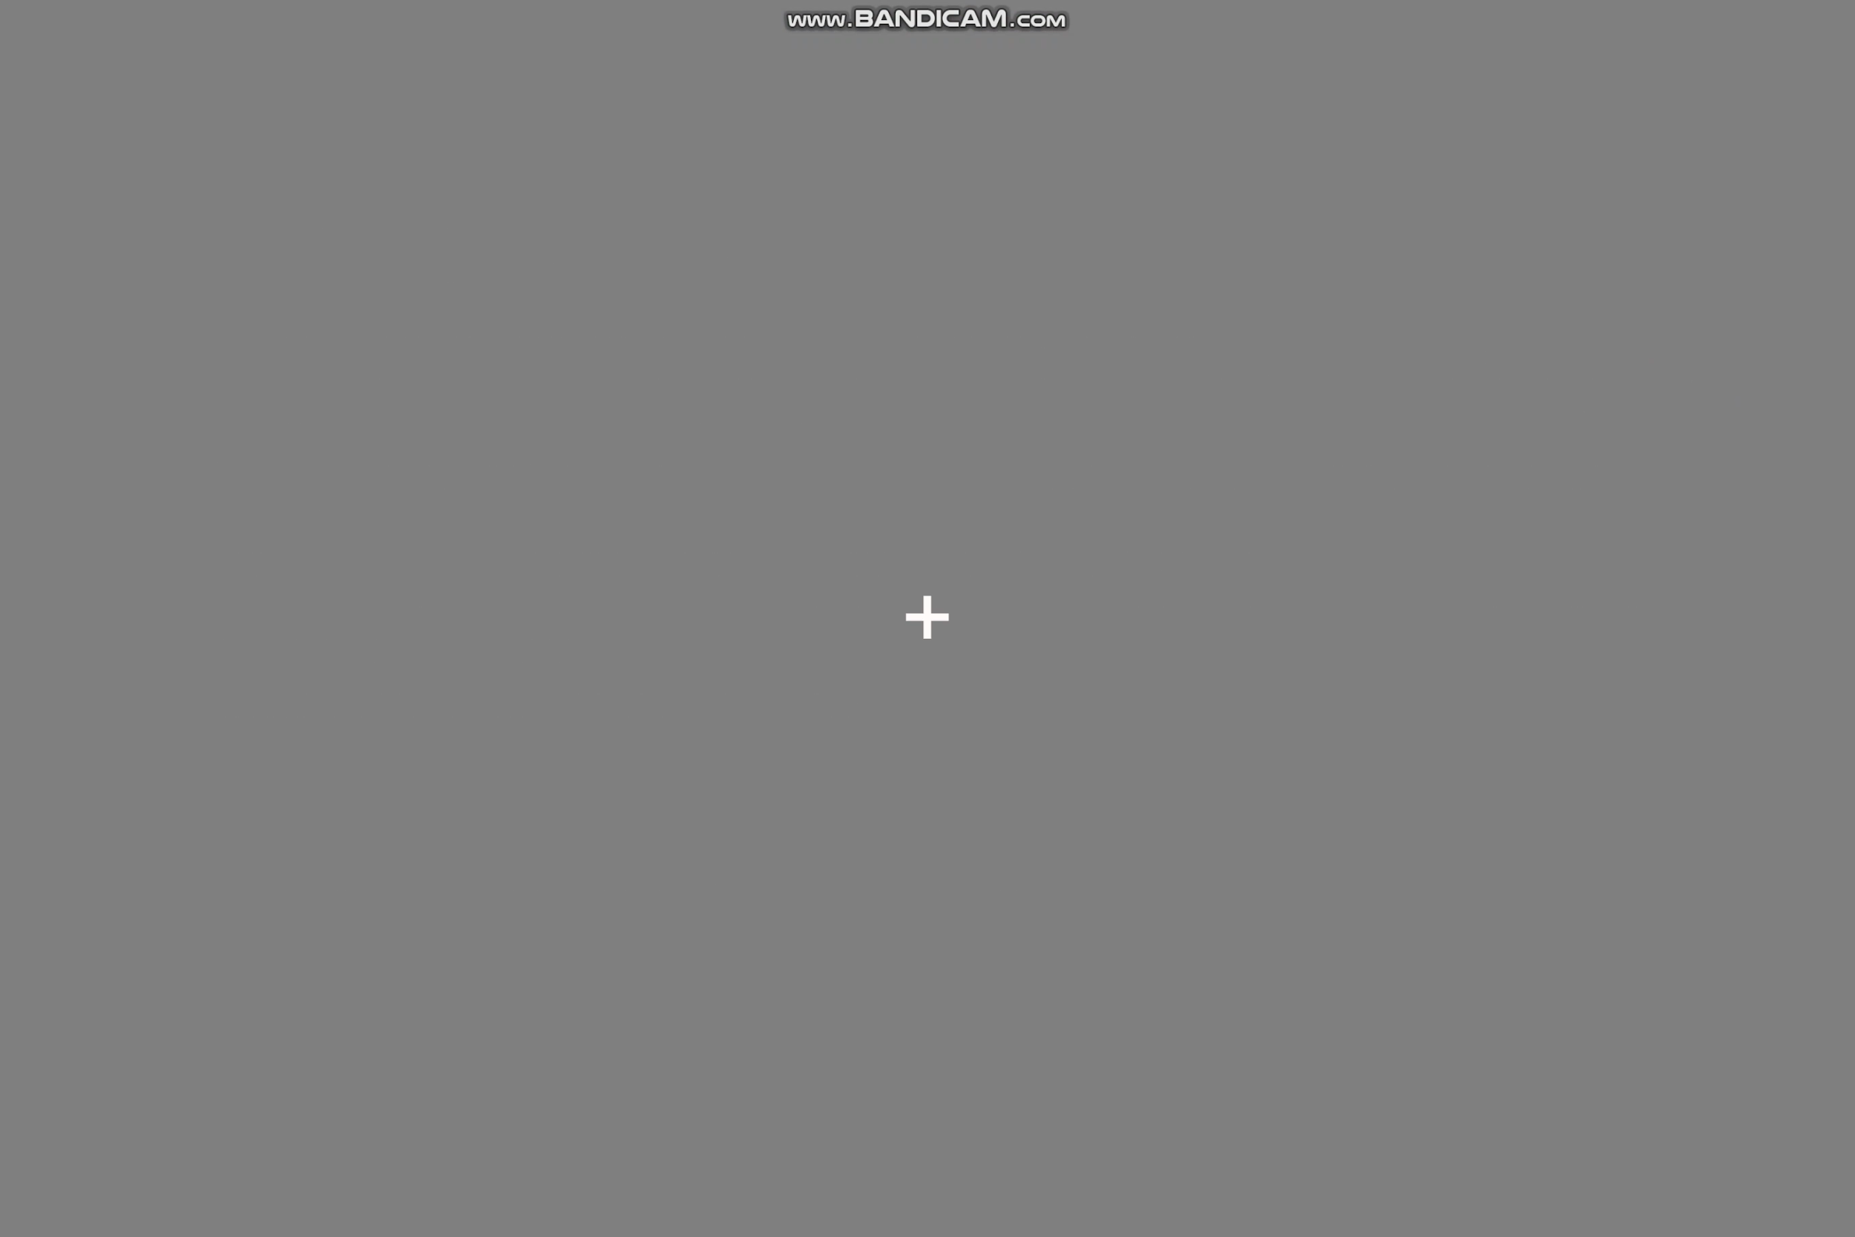
Basic procedure / basic design
STEP 1: Fixation
Participants fixate on the cross at the centre of the screen for 500 ms

Slide 5
Procedure
STEP 2: Image Presentation
After fixation, an Image will be presented on the centre of the screen for 133ms. Then this image will be masked out by 5 masks, and each mask last 60ms. So the masking time period will be 300ms in total.

Slide 6
Procedure
STEP 3: Patch presentation
After the image presentation, another 500ms fixation will be presented. Then a patch of image will be flashed briefly (133ms) on the screen, followed by mask (300 ms). The patch can appear in one of the 9 positions, but it will be in the same location where the patch occupied in the original image. (See the demo below).

Slide 7
Procedure
STEP 4: Patch presence/absence decision
After the mask, participants will be asked a question about if the patch was a part of the image shown before, together with the confidence from 1 to 4 (8 AFC). After the click, they are asked to click the central square to avoid keep on pressing the same response.

Slide 8
Strategy
Image
All 140 images (140 congruent-incongruent pairs I suppose?) in the data base have been used
Presentation Order
Ensure the experiments between different subjects can have different order list
Image congruency
Can be Congruent or Incongruent
Patch types
Each trial has 21 patches to present and the present order need to be complete random
When Critical Patch is in EVEN position : 4 patches from present image + 1 critical patch from reverse Image + 16 absent patches
When Critical Patch is in ODD position : 5 patches from present image + 1 critical patch from reverse Image + 15 absent patches

Slide 9
Trial schedule
 | Subject 1 | Subject 2 | ... | Subject 18
Group 1 (14 images) | Random order list for image 1 to 140 | Random order list for image 1 to 140 | ... | Random order list for image 1 to 140
Group 2 (14 images)
Group 3 (14 images)
Group 4 (14 images)
Group 5 (14 images)
Group 6 (14 images)
Group 7 (14 images)
Group 8 (14 images)
Group 9 (14 images)
Group 10 (14 images)

Slide 10

Trial schedule
Subject X:
Pool of Images: 140 Index: 1-140
Shuffle the images
Divide into 10 groups
Each group has 10 images
G1
G2
G3
G4
G5
G6
G7
G8
G9
G10

Slide 11
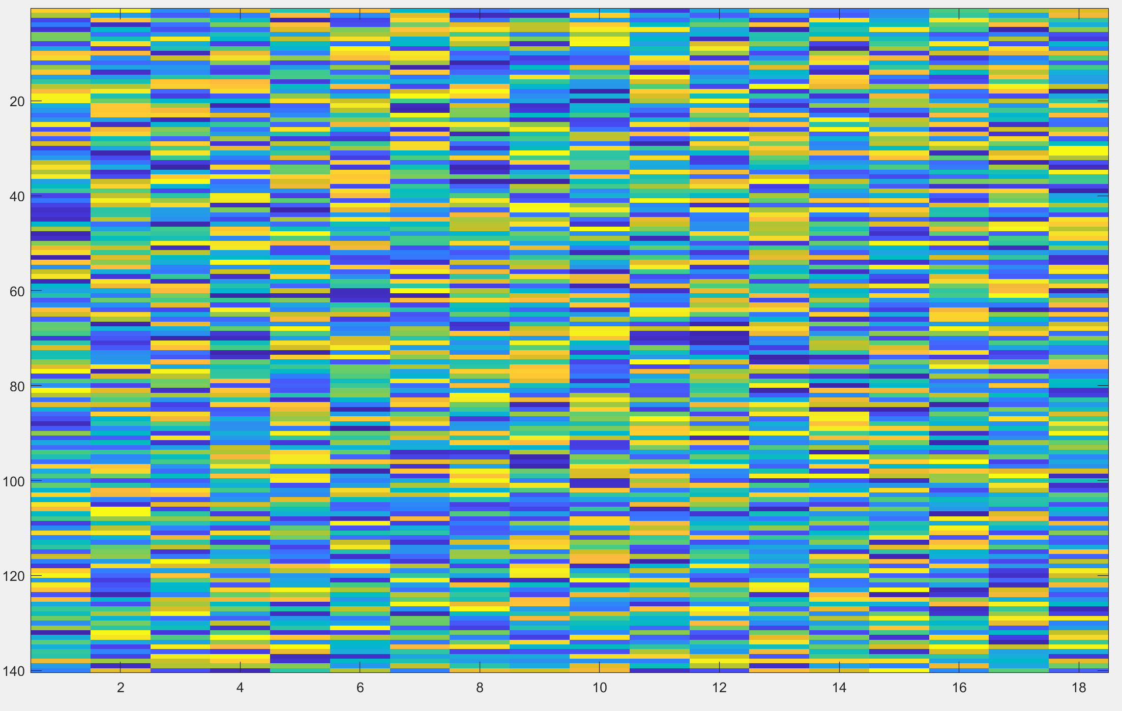
Trial schedule
imagesc.m
Image order for 18 Subjects
Image Index order list(In 7 groups from 1-140)
Subject (1-18)

Slide 12
Qianchen’s Version vs Van’s Version
 | Qianchen | Van
Instruction & practice [Minor] | 133 x 3 | 3 trials, 500, 250, 133
# of trials per participant [Important] | 80 (2 hours, 2 days) | 14 (20 min)
Order of image present | Fix | Random
# of particpants | 18? | 10 groups x 18 subject = 180 participants
# of patches from the original | 4 or 5 | 4 or 5
# of patche with a critical object replaced | 1 | 1
# of null patches [minor] | 15 | 16 or 15 (to keep # of questions same)
null patch location | random from 12 | random from 12
proportion of congruent/incongruent | 50/50(%) | 50/50(%)

Slide 13
Advantage vs. Disadvantage
Advantage
File size is relatively small (around 10mb) and easy to upload and download from the website
Can collect a large number of data from all around the world which can make the data analysis more reliable
Disadvantage
We found that when the subject download from the website, they still need around 6 min even the size of the file is not big.
The downloading time depends on the number of files which need to be downloaded.
To Do:
1. Find a way to reduce the downloading time period
2. Create some links to be used for pilot and make a pre data analysis

